Slide 2
Internetworking
Definition of Internetworking:
Internetworking refers to the practice of connecting multiple networks together to form a larger network. This allows for seamless communication and data exchange between different network segments.
Significance of Internetworking:
Internetworking is crucial for enabling different systems to communicate, share resources, and access information across diverse networks. It forms the backbone of the modern Internet.
Real-World Example:
Consider a company with multiple branch offices. Internetworking allows employees in different locations to access shared resources, communicate via email, and collaborate on projects seamlessly.

Slide 3
The Evolution of Networking
The development of ARPANET, one of the first networks, started modern networking by allowing computers to connect in a limited area, setting the stage for larger networks
1960s
Ethernet technology improved Local Area Networks (LANs), making it easier to share resources like printers and files between nearby computers. Its speed and reliability became the standard for wired LANs.
1980s
The introduction of the Internet Protocol Suite (TCP/IP) unified networking protocols, enabling different networks to connect. This helped expand Wide Area Networks (WANs) and global connectivity, leading to the creation of the internet.
1990s
The rise of Wi-Fi made it possible for devices to connect wirelessly, making networking more flexible and convenient. It allowed mobile devices to access the internet and share resources without cables.
2000s

Slide 4
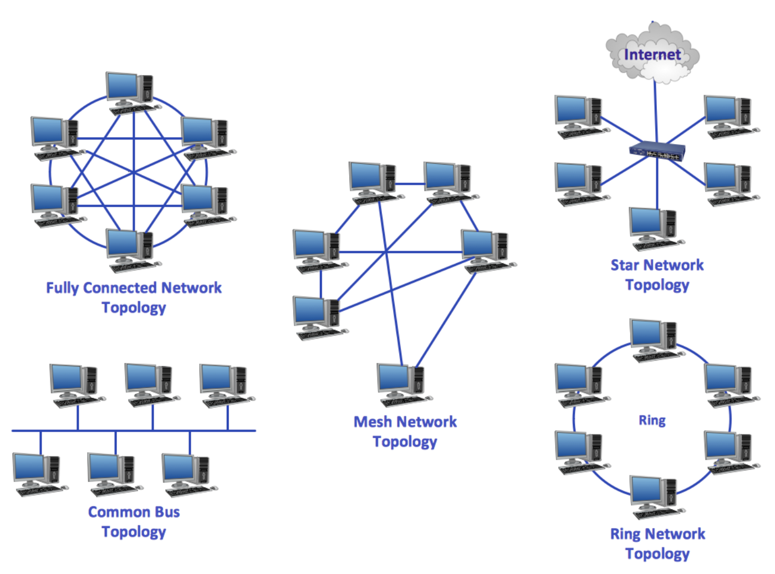
Types of Networks
Local Area Network (LAN): A LAN connects computers within a small area like a home, office, or school. It allows for fast data transfer and sharing of resources like printers and files.
Metropolitan Area Network (MAN): A MAN covers a larger area than a LAN, such as a city or a large campus. It connects multiple LANs and allows communication over a broader region.
Wide Area Network (WAN): WANs link multiple LANs over long distances, often through leased telecommunication lines. The Internet is a major example of a WAN, enabling global connectivity.
Personal Area Network (PAN): A PAN is a small network, usually within a few meters, connecting personal devices like smartphones, tablets, and laptops via Bluetooth or Wi-Fi.

Slide 6
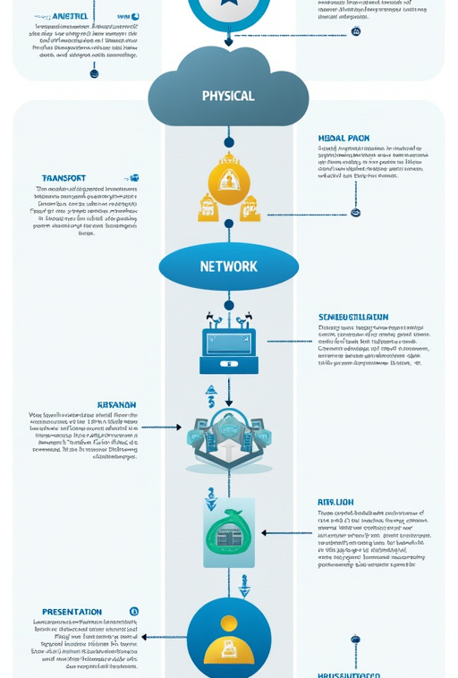
Understanding the OSI Model
Introduction to the OSI Model
The OSI (Open Systems Interconnection) model is a conceptual framework that standardizes the functions of a networking system into seven layers, promoting interoperability between different systems.
Purpose of the OSI Model
The OSI model provides a systematic approach to understanding how data is transmitted across networks. It helps in troubleshooting communication issues by isolating problems to specific layers.

Slide 7
Layers of the OSI Model:
The OSI model consists of seven layers:
Physical Layer: Handles the physical connection between devices.
Data Link Layer: Manages data transfer between adjacent network nodes.
Network Layer: Responsible for routing data packets across networks.
Transport Layer: Ensures reliable data transfer between hosts.
Session Layer: Manages sessions between applications.
Presentation Layer: Translates data formats for the application layer.
Application Layer: Interfaces directly with end-user applications.

Slide 8
Importance of the OSI Model
The OSI model simplifies networking concepts, troubleshooting, and interoperability through its structured framework of seven layers:
Framework for Networking: The OSI model organizes complex networking processes into manageable layers, helping professionals understand and communicate about networks effectively.
Troubleshooting: It isolates issues to specific layers (e.g., physical, data link, or application), streamlining problem resolution.
Protocol Standardization: By promoting standardization, the OSI model ensures diverse devices and systems can communicate efficiently.
Interoperability: It enables seamless collaboration between different technologies, crucial for global connectivity.
Real-World Use: IT professionals use the OSI model to design, implement, and manage networks, ensuring reliable communication and improved performance.

Slide 9
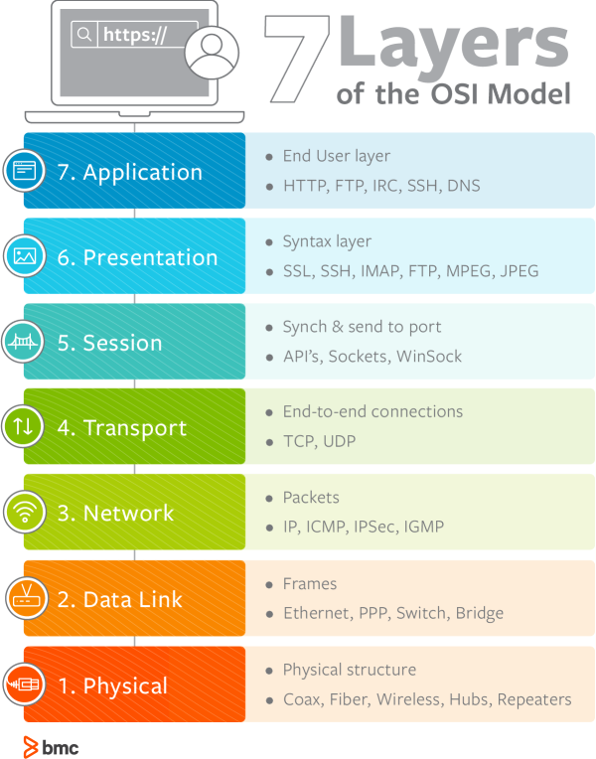
OSI Model Layers Explained
Physical Layer
The Physical layer defines the hardware elements involved in data transmission, including cables, switches, and network interface cards. It specifies how bits are transmitted over a physical medium.
Data Link Layer
The Data Link layer ensures error-free data transfer between two directly connected nodes. It uses MAC addresses to identify devices and frames to encapsulate data.
Network Layer
The Network layer is responsible for determining the best path for data to travel across networks. It uses logical addressing (IP addresses) to route packets.

Slide 10
Transport Layer
The Transport layer manages end-to-end communication, ensuring complete data transfer through error detection and correction. It uses protocols like TCP and UDP.
Session Layer
The Session layer establishes, maintains, and terminates connections between applications. It manages sessions and controls data exchange.
Presentation Layer
The Presentation layer translates data formats, ensuring that data is presented in a readable format for the application layer. It handles encryption and compression.
Application Layer
The Application layer is the closest layer to the end user, providing network services to applications. It includes protocols like HTTP, FTP, and DNS.

Slide 12
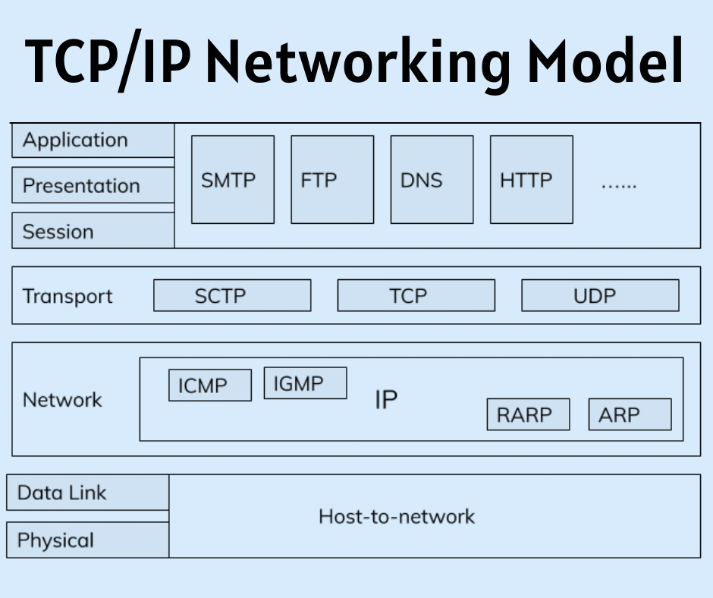
Introduction to the TCP/IP Model
Overview of the TCP/IP Model
The TCP/IP model is a concise framework for understanding networking protocols and architecture, consisting of four layers that correspond to the OSI model's seven layers.
Historical Background
Developed in the 1970s, TCP/IP was designed to facilitate communication over the Internet. It has become the dominant protocol suite due to its robustness and flexibility.
Essential in Modern Networking
The TCP/IP model is essential for modern networking, enabling devices to communicate over the Internet and supporting a wide range of applications and services.
\

Slide 13
Comparison to the OSI Model
While the OSI model provides a detailed framework, the TCP/IP model is more streamlined, focusing on the practical implementation of protocols in real-world scenarios.
Layers of the TCP/IP Model
The TCP/IP model consists of four layers:
Link Layer: Corresponds to the OSI's Physical and Data Link layers.
Internet Layer: Corresponds to the OSI's Network layer.
Transport Layer: Corresponds to the OSI's Transport layer.
Application Layer: Corresponds to the OSI's Session, Presentation, and Application layers.

Slide 14
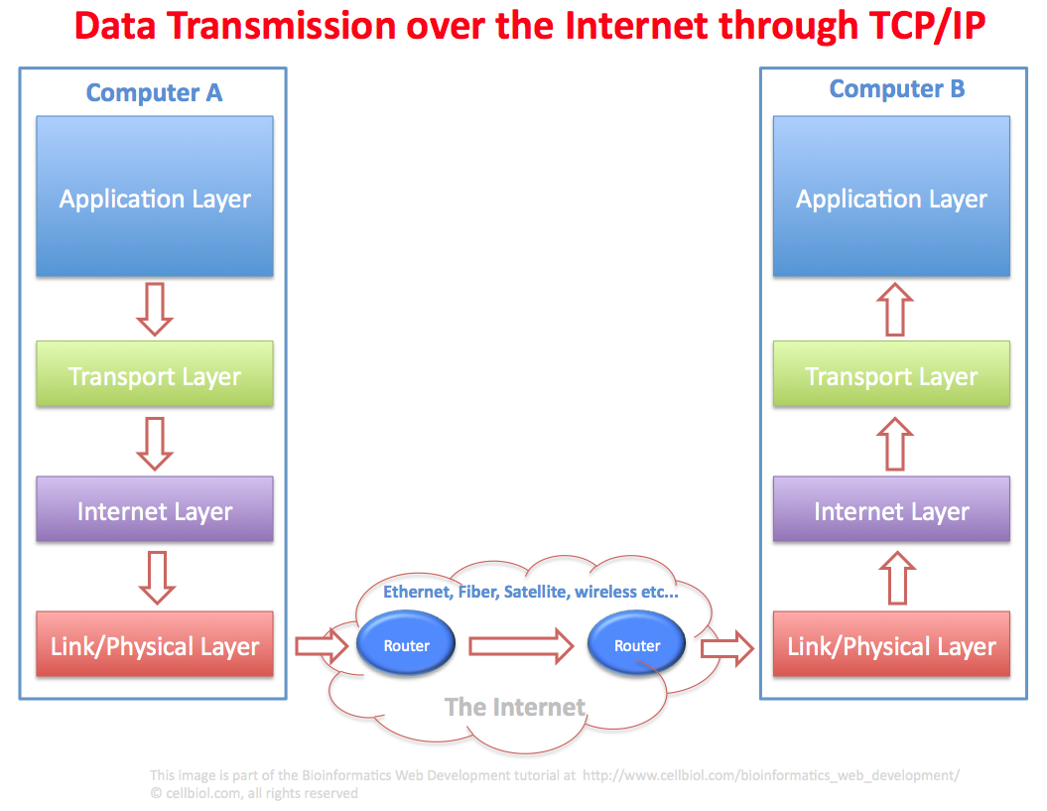
Practical Implementation of TCP/IP
Everyday Use of TCP/IP
TCP/IP is the backbone of the Internet, enabling a wide range of applications and services that we use daily.
Web Browsing
When you access a website, your browser uses HTTP over TCP/IP to request web pages from servers, facilitating the exchange of information.
Email Communication
Email protocols like SMTP and POP3 operate over TCP/IP, allowing users to send and receive messages seamlessly.

Slide 15
File Transfers
Protocols like FTP and SFTP enable file transfers over TCP/IP, allowing users to upload and download files from servers.
Streaming Services
Streaming platforms utilize TCP/IP to deliver audio and video content, ensuring smooth playback and minimal buffering.
Summary
TCP/IP is integral to daily Internet operations, enabling various applications and services that enhance our online experiences.

Slide 17
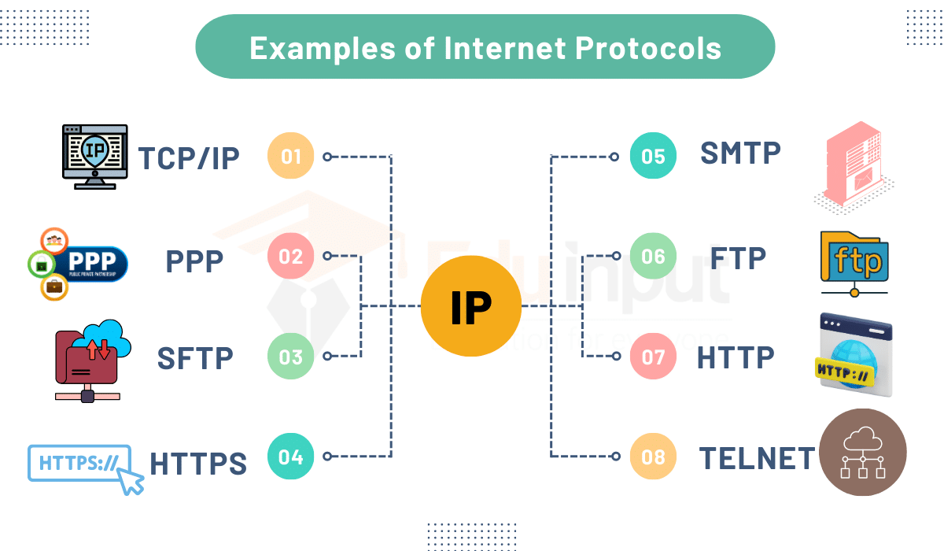
Importance of Protocols in Networking
Standardization of Communication
Protocols standardize communication processes across different systems, ensuring devices can connect and exchange data effectively.
Ensuring Compatibility
Protocols ensure that devices from different manufacturers can communicate seamlessly, promoting interoperability in networking.

Slide 18
Facilitating Data Exchange
Protocols define how data is formatted, transmitted, and received, enabling smooth data exchange between devices and applications.
Enhancing Security
Many protocols include security features, such as encryption and authentication, ensuring secure communication over networks.

Slide 19
TCP and UDP
Aspect | TCP (Connection-oriented) | UDP (Connectionless)
Connection Type | Connection-oriented | Connectionless
Reliability | Reliable delivery | Unreliable delivery
Error Checking | Yes | No
Speed | Slower | Faster
Use Cases | Web browsing, email | Streaming, gaming

Slide 20
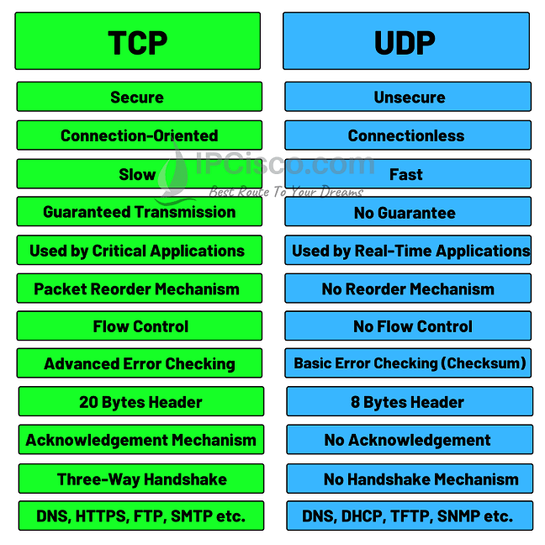
Summary of Differences
TCP is ideal for applications requiring reliable data transmission, such as file transfers or email. On the other hand, UDP is better suited for applications prioritizing speed and low latency, such as live streaming and gaming.
Real-World Examples
TCP: Downloading a file, sending an email, or accessing a webpage where data integrity is essential. UDP: Watching a live sports event or playing an online game, where real-time delivery is more important than guaranteed delivery of each data packet.

Slide 21
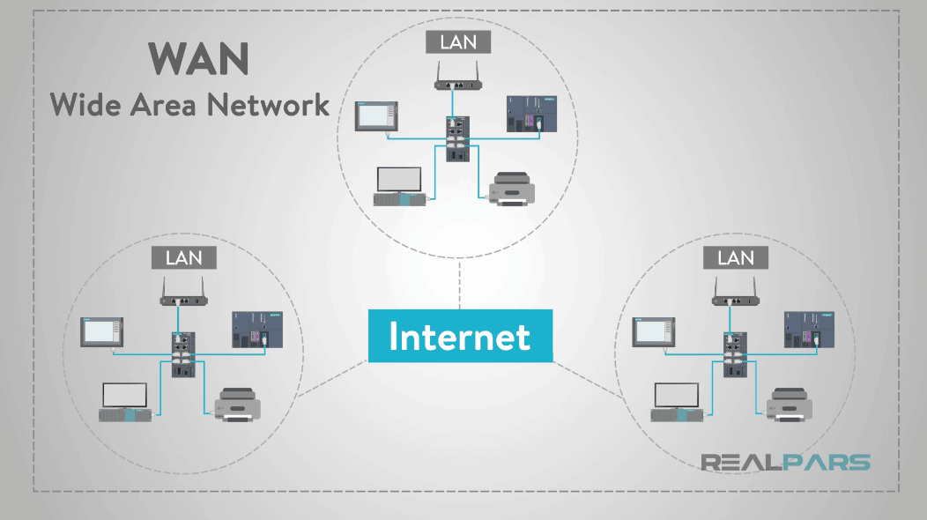
Ethernet
Explanation of Ethernet Technology
Ethernet is a widely used networking technology that facilitates communication over wired connections in local area networks (LANs). It defines standards for data transmission, allowing devices to connect and communicate within a network.
Significance in Local Area Networks
Ethernet has become the dominant technology for LANs due to its reliability, speed, and simplicity. It enables devices to connect seamlessly, ensuring effective communication and resource sharing in small to medium-sized networks, such as those in offices or homes.

Slide 22
How Ethernet Works
Ethernet uses a system of frames to encapsulate data for transmission. Each frame consists of several components, including source and destination MAC (Media Access Control) addresses, which uniquely identify devices on the network. This ensures that data is transmitted to the correct device, preventing misdelivery.
Real-World Example
In an office environment, Ethernet cables are used to connect computers, printers, and servers, allowing for seamless data transfer and resource sharing. For example, when an employee prints a document, the data travels through the Ethernet network to the printer, ensuring a fast and reliable print job.

Slide 23

Wireless Standards and Protocols
Introduction to Wireless Standards
Wireless communication standards define the specifications for data transmission over wireless networks. These standards ensure that devices from different manufacturers can work together seamlessly, providing compatibility and interoperability. They define key parameters like frequency bands, data rates, and communication protocols.
Notes:
### Introduction to Wireless Standards
Wireless communication standards define the specifications for data transmission over wireless networks, ensuring compatibility and interoperability among devices.
### IEEE 802.11 Standards
The IEEE 802.11 family of standards governs WLANs, with various versions offering different speeds and features:
**802.11a**: 54 Mbps over 5 GHz frequency.
**802.11b**: 11 Mbps over 2.4 GHz frequency.
**802.11g**: 54 Mbps over 2.4 GHz frequency.
**802.11n**: Up to 600 Mbps using multiple antennas.
**802.11ac**: Gigabit speeds over 5 GHz frequency.
### Summary of Applications and Differences
Different wireless standards are used based on requirements for speed, range, and interference resistance, making it essential to choose the appropriate standard for specific applications.
### Visuals for Standards
Diagrams comparing the various IEEE 802.11 standards can help illustrate their differences and applications in real-world scenarios.

Slide 24
Wireless Standards and Protocols
IEEE 802.11 Standards
The IEEE 802.11 family of standards governs wireless local area networks (WLANs), ensuring reliable and efficient communication over Wi-Fi networks. Different versions of the standard offer various capabilities, including different data rates, frequency bands, and ranges:
802.11a: Provides speeds of up to 54 Mbps over the 5 GHz frequency band. It has a shorter range due to the higher frequency but experiences less interference from other devices operating on the 2.4 GHz band.
802.11b: Offers speeds of up to 11 Mbps over the 2.4 GHz frequency band. It has a longer range but is more susceptible to interference from other devices, such as microwaves and Bluetooth devices, which also operate on the 2.4 GHz band.
Notes:
### Introduction to Wireless Standards
Wireless communication standards define the specifications for data transmission over wireless networks, ensuring compatibility and interoperability among devices.
### IEEE 802.11 Standards
The IEEE 802.11 family of standards governs WLANs, with various versions offering different speeds and features:
**802.11a**: 54 Mbps over 5 GHz frequency.
**802.11b**: 11 Mbps over 2.4 GHz frequency.
**802.11g**: 54 Mbps over 2.4 GHz frequency.
**802.11n**: Up to 600 Mbps using multiple antennas.
**802.11ac**: Gigabit speeds over 5 GHz frequency.
### Summary of Applications and Differences
Different wireless standards are used based on requirements for speed, range, and interference resistance, making it essential to choose the appropriate standard for specific applications.
### Visuals for Standards
Diagrams comparing the various IEEE 802.11 standards can help illustrate their differences and applications in real-world scenarios.

Slide 25
802.11g: Provides speeds of up to 54 Mbps over the 2.4 GHz frequency band. It combines the longer range of 802.11b with the faster speed of 802.11a, but it still suffers from the same interference issues associated with the 2.4 GHz band.
802.11n: Supports speeds of up to 600 Mbps and uses multiple antennas (MIMO – Multiple Input, Multiple Output) to improve data throughput and range. It can operate on both the 2.4 GHz and 5 GHz frequency bands, offering flexibility in network design.
802.11ac: Provides gigabit speeds (up to 1 Gbps and beyond) over the 5 GHz frequency band. It uses advanced techniques such as beamforming and wider channels to improve speed and reduce interference. This standard is ideal for high-bandwidth applications like video streaming and online gaming.

Slide 26

Comparison Between UTP and STP
Feature | UTP | STP
This slide contains additional content. Please find it under the speaker notes below.
💡 SlidesAI Tip
Notes:
Comparison Table:

Slide 27
|
Enter text

Slide 28
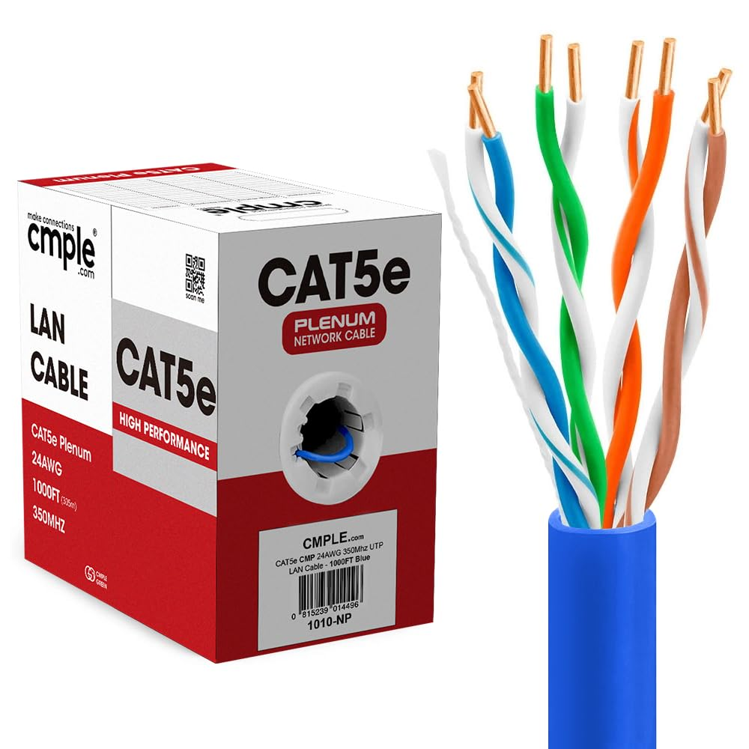
Practical Applications of Each Category
### Real-World Examples of Cable Usage
**CAT5e**: Used in small office networks for standard internet connectivity.
**CAT6**: Commonly used in enterprise environments where high-speed connections are required.
**CAT6a**: Ideal for data centers needing high-speed connections over longer distances.
**CAT7**: Used in environments with high interference, ensuring reliable performance.
**CAT8**: Employed in data centers for high-speed connections between servers and switches.
### Summary
Selecting the appropriate cable category based on real-world applications is crucial for optimizing network performance and reliability.

Slide 29
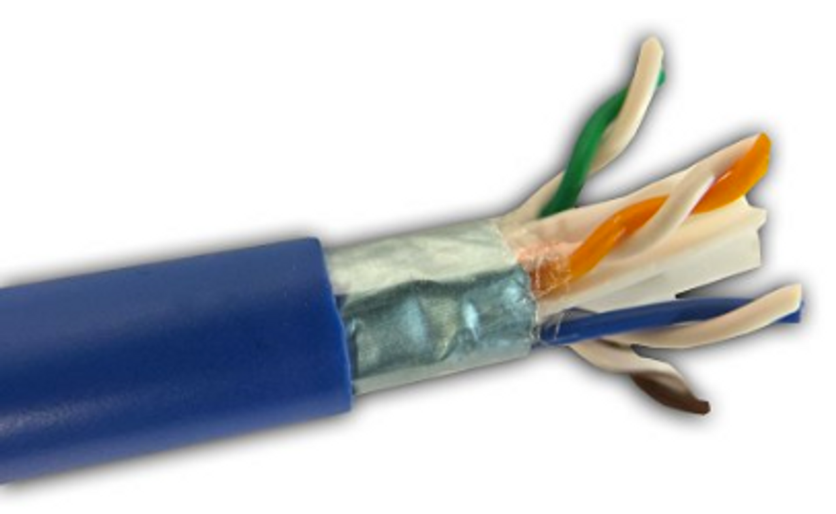
Real-World Applications of CAT5e
### Examples of CAT5e Deployment
**Residential Networks**: Used in homes to connect computers, smart TVs, and gaming consoles to the internet.
**Small Office Networks**: Employed in small businesses for reliable connectivity among devices, such as computers and printers.
**Educational Institutions**: Used in schools and universities to connect classrooms and labs to the internet.
### Summary
CAT5e cables are widely used in various real-world applications, providing reliable connectivity for both residential and commercial environments.

Slide 30
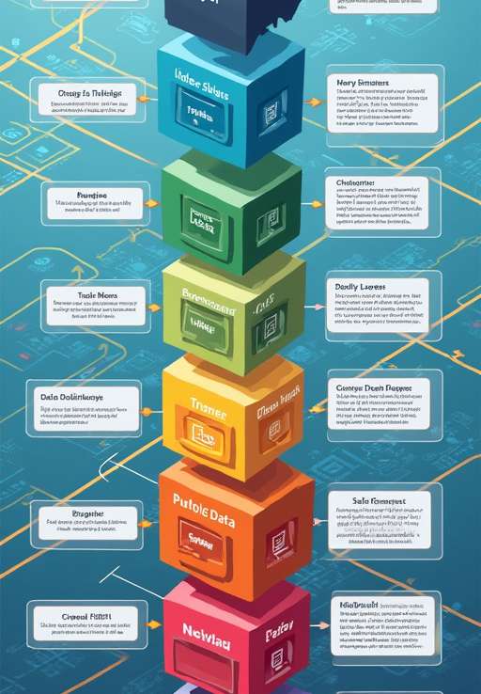
Visualization of the OSI Model
Visualizing the OSI model enhances comprehension of how data is transmitted and processed across different layers, emphasizing the importance of each layer's function.
**Diagram of the OSI Model**: A visual representation of the OSI model can illustrate the seven layers and their functions, making it easier to understand how data flows through a network.
**Layer Descriptions**: Each layer can be described alongside the diagram, highlighting its role and the protocols associated with it, such as:
**Physical Layer**: Ethernet; **Data Link Layer**: PPP; **Network Layer**: IP; **Transport Layer**: TCP, UDP; **Session Layer**: NetBIOS; **Presentation Layer**: SSL; **Application Layer**: HTTP, FTP.
**Examples of Protocols**: Providing examples of common protocols associated with each layer can help solidify understanding of the OSI model's practical applications.

Slide 31
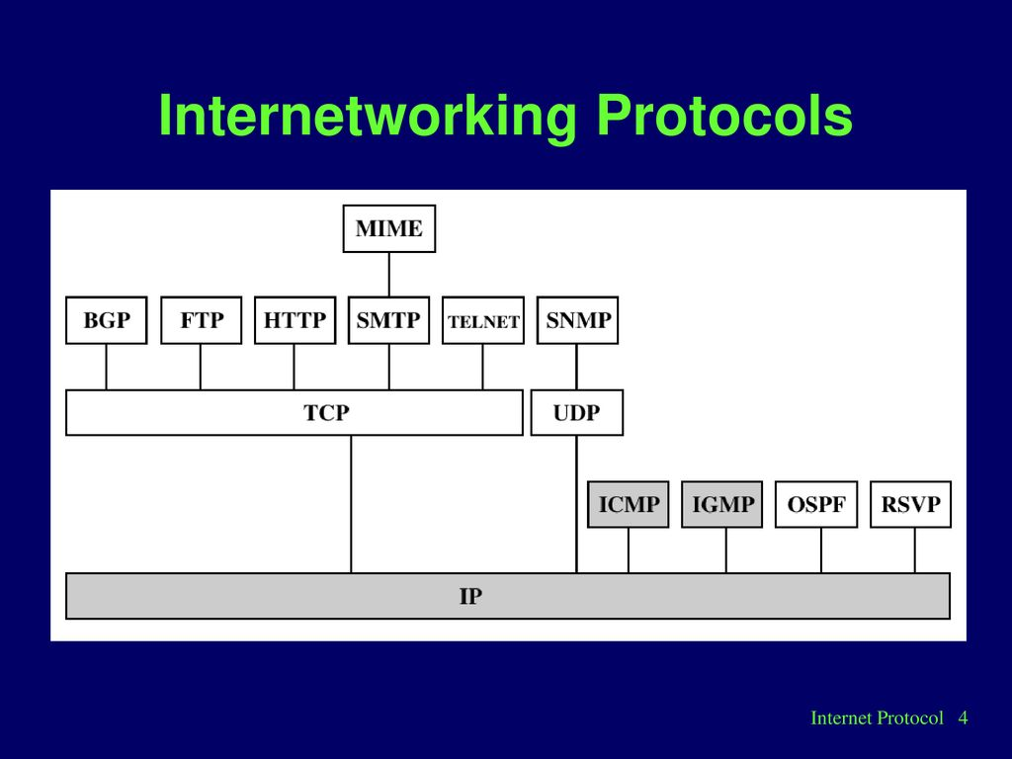
Common Internetworking Protocols
Introduction to Common Protocols: Internetworking protocols are essential for facilitating communication between devices on different networks. They define rules and conventions for data exchange.
**TCP/IP** (Transmission Control Protocol/Internet Protocol): TCP/IP is the foundational protocol suite for the Internet. It breaks data into packets for transmission and ensures reliable delivery through error checking and retransmission.
**HTTP** (Hypertext Transfer Protocol): HTTP is the protocol used for transmitting web pages. It enables communication between web browsers and servers, allowing users to access and interact with online content.
**FTP** (File Transfer Protocol): FTP is used for transferring files between computers over a network. It allows users to upload and download files securely.
**SMTP** (Simple Mail Transfer Protocol): Used for sending emails.
**DNS** (Domain Name System): Translates domain names into IP addresses.

Slide 32
Layers of the TCP/IP Model
Link Layer
Internet Layer
Transport and Application Layers
The **Link layer** is responsible for the physical connection between devices and the data transfer over a specific medium, including protocols like **Ethernet** and **Wi-Fi**.
The **Internet layer** manages the routing of data packets across networks using the **Internet Protocol (IP)** to address and route packets.
The **Transport layer** ensures reliable data transfer between hosts with protocols like **TCP** and **UDP**. The **Application layer** interfaces directly with end-user applications, including protocols like **HTTP**, **FTP**, and **DNS**.

Slide 33
Comparison of OSI and TCP/IP
Overview of OSI vs. TCP/IP
Strengths and Weaknesses
The **OSI model** and **TCP/IP model** are both frameworks for understanding networking, but they differ in structure and application.
The **OSI model** offers a **detailed framework** and a **layered approach**, while the **TCP/IP model** is known for its **simplicity** and **widespread adoption**. However, the OSI model can be **complex** and less adopted, whereas the TCP/IP model lacks **detailed structure**.

Slide 34
Understanding Internet Protocols
Definition and Role
Categorization of Protocols
Key Protocols
**Internet protocols** are standardized rules that govern how data is transmitted over the Internet, ensuring devices can communicate effectively.
Internet protocols can be categorized into several types: **Network Protocols** (e.g., **IP**), **Transport Protocols** (e.g., **TCP**, **UDP**), and **Application Protocols** (e.g., **HTTP**, **FTP**).
Key protocols include **IP** for addressing and routing packets, **TCP** for reliable data delivery, and **UDP** for fast, connectionless communication.

Slide 35
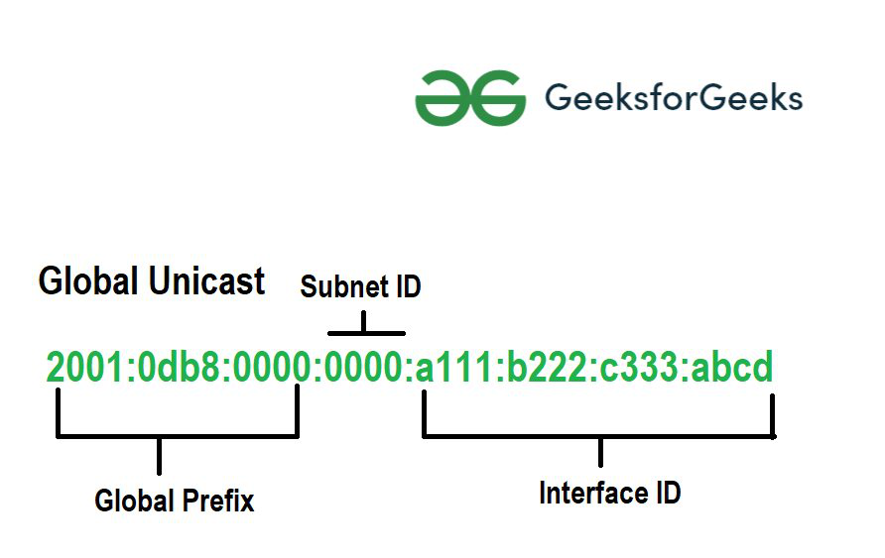
IPv4 vs. IPv6
Overview of IPv4 and Limitations
Introduction to IPv6 and Improvements
IPv4 (Internet Protocol version 4) is the most widely used addressing scheme, utilizing **32-bit addresses**. However, it faces **address exhaustion** due to the rapid growth of the Internet.
IPv6 (Internet Protocol version 6) addresses IPv4's limitations with **128-bit addresses**, allowing for an almost unlimited number of unique addresses. It offers a **larger address space**, **simplified addressing**, and **enhanced security** features.

Slide 36
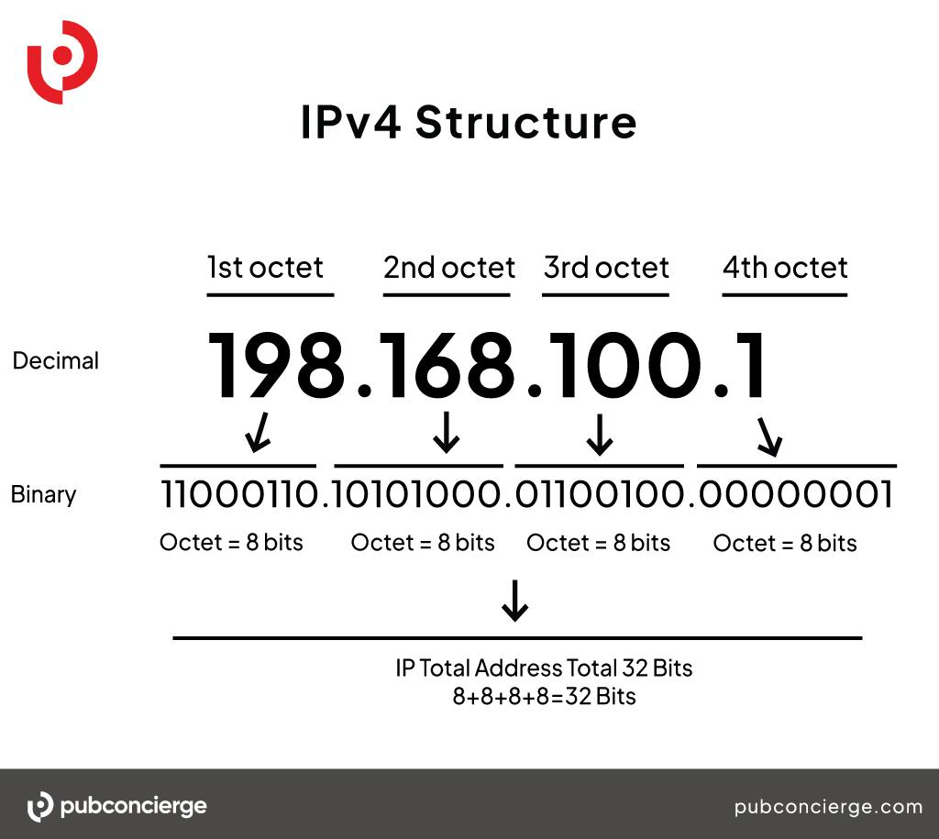
Role of Subnetting
Definition of Subnetting: Subnetting is the practice of dividing a larger network into smaller, more manageable subnetworks (subnets). It enhances network performance and security.
**Efficient IP Address Management**: Subnetting allows for better utilization of IP addresses, reducing wastage.
**Improved Network Performance**: Smaller subnets reduce network congestion and improve data transmission speeds.
**Enhanced Security**: Subnets can be isolated from each other, limiting access and improving security.

Slide 37
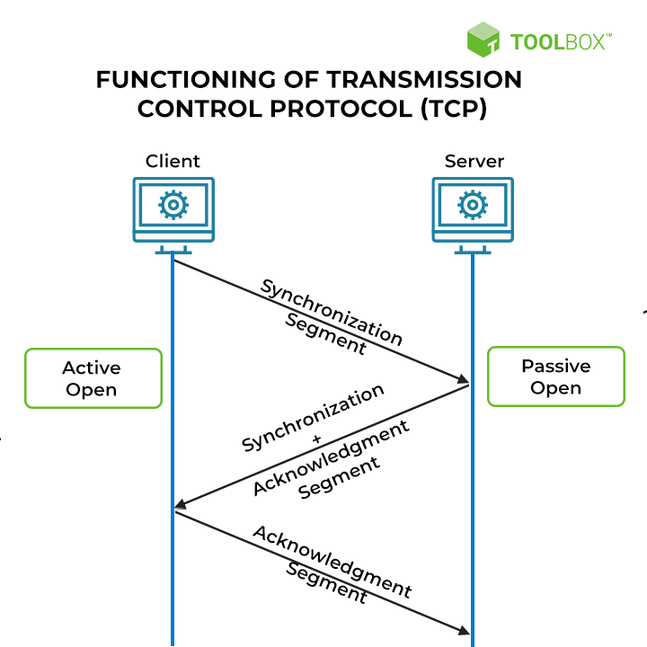
TCP vs. UDP: Which to Use
Definition of TCP: TCP (Transmission Control Protocol) is a connection-oriented protocol that ensures reliable data transmission through error checking and retransmission.
**Reliability**: TCP guarantees that data is delivered accurately and in order.
**Connection-Oriented**: A connection must be established before data transfer.
**Error Checking**: TCP includes mechanisms for detecting and correcting errors.
**Speed**: UDP is faster than TCP due to its connectionless nature.
**Low Latency**: Ideal for applications where speed is critical, such as streaming.

Slide 38

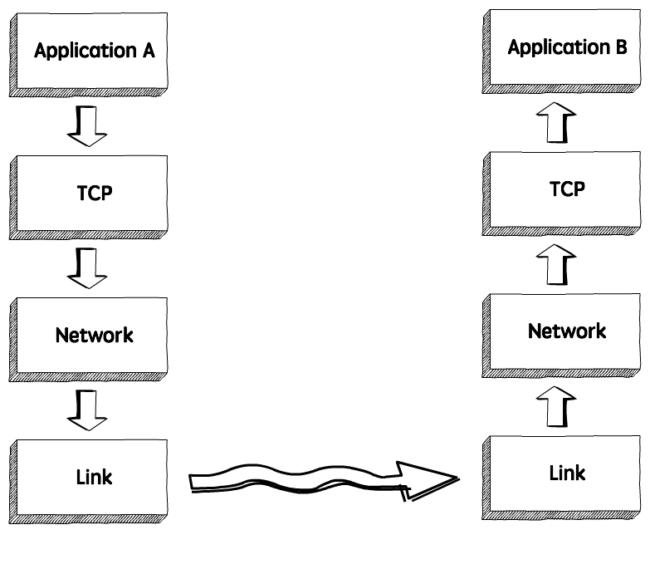
TCP Characteristics
Connection-Oriented Communication
Error Checking and Data Reliability
Flow Control and Real-World Example
**TCP** establishes a **connection** between sender and receiver before transmitting data, ensuring that both parties are ready to communicate.
**TCP** includes **error-checking mechanisms** to detect and correct data transmission errors, ensuring accurate delivery of information. It guarantees that all data packets are received in the correct order, retransmitting any lost packets.
**TCP** uses **flow control mechanisms** to manage the rate of data transmission, preventing network congestion. For example, when you download a file from the Internet, **TCP** ensures that the entire file is received accurately and in the correct order.

Slide 39
UDP Characteristics
Connectionless Communication and Low Latency
Simplicity and No Error Checking
Use Cases and Summary
**UDP** does not establish a **connection** before transmitting data, allowing for faster data transfer without the overhead of connection setup. This results in **lower latency**, making it ideal for real-time applications.
**UDP** is simpler than **TCP**, with fewer features and overhead, allowing for faster data transmission. However, it does not guarantee the delivery of packets or their order, making it less reliable.
**UDP** is commonly used for **streaming** and **online gaming**, where speed is prioritized over reliability. Its connectionless nature and simplicity make it suitable for applications requiring quick communication.

Slide 40

How Ethernet Works
Overview of Ethernet Operation: Ethernet operates by transmitting data in frames over a physical medium, such as twisted-pair cables or fiber optics. Each frame contains essential information for data delivery.
**Frame Creation**: Data is encapsulated into frames, including source and destination MAC addresses.
**Collision Detection**: Ethernet uses a Carrier Sense Multiple Access with Collision Detection (CSMA/CD) protocol to manage access to the network.
**Data Transmission**: Frames are transmitted over the network medium to the intended recipient.

Slide 41
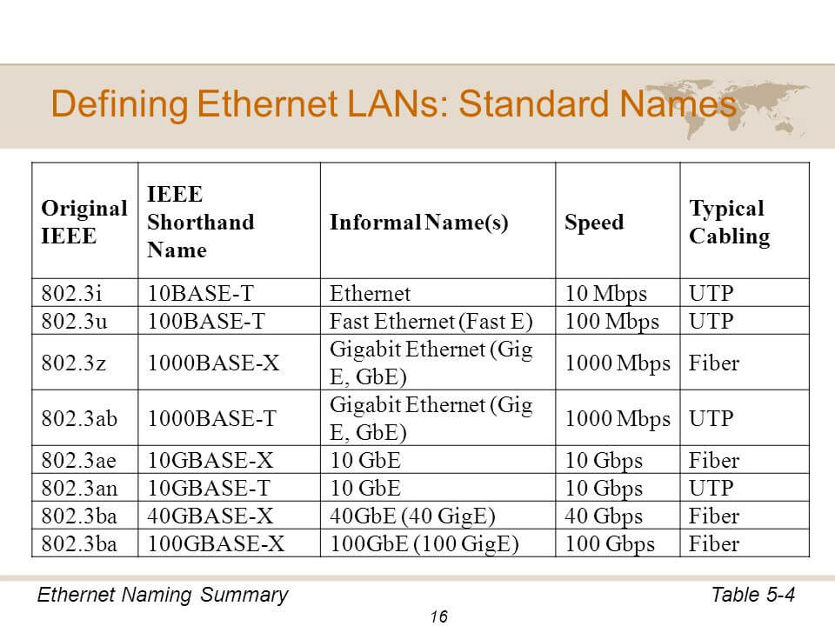
Ethernet Standards
Overview of Ethernet Standards: Ethernet standards define the specifications for data transmission speeds, cable types, and network configurations. They ensure compatibility and interoperability among devices.
**10BASE-T**: Supports speeds of 10 Mbps over twisted-pair cables.
**100BASE-TX**: Supports speeds of 100 Mbps over twisted-pair cables.
**1000BASE-T**: Supports speeds of 1 Gbps over twisted-pair cables.

Slide 42
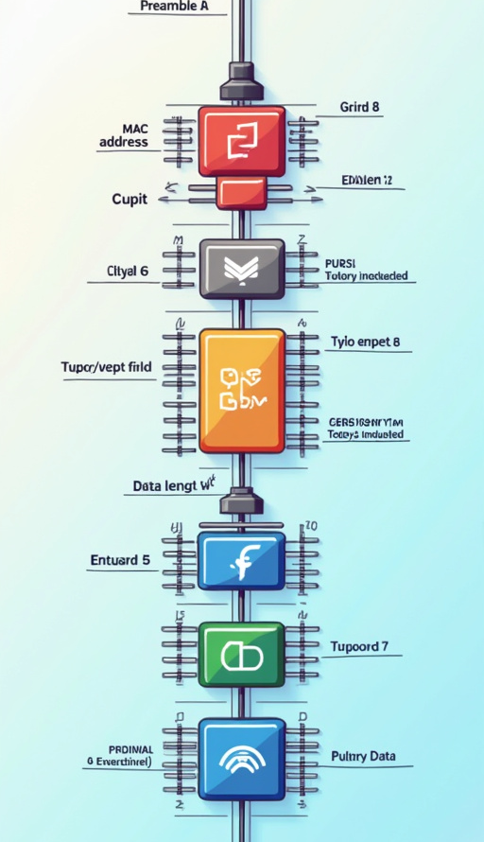
Ethernet Frame Structure
Elements of Ethernet Frame Structure: An Ethernet frame consists of several key elements that facilitate data transmission:
**Preamble**: A series of bits used for synchronization.
**MAC Addresses**: Source and destination addresses for identifying devices.
**Type/Length Field**: Indicates the type of data contained in the frame or its length.
**Data Payload**: The actual data being transmitted.
**Frame Check Sequence (FCS)**: A checksum used for error detection.

Slide 43
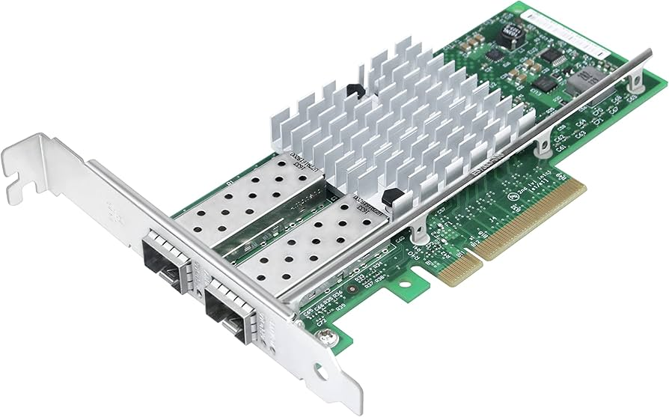
Advanced Ethernet Technologies
Overview of Advanced Ethernet Technologies: Advanced Ethernet technologies enhance network management and performance, providing additional features and capabilities beyond standard Ethernet.
**Virtual Local Area Networks (VLANs)**: VLANs allow network administrators to segment networks logically, improving security and performance by isolating traffic within specific groups.
**Quality of Service (QoS)**: QoS mechanisms prioritize certain types of traffic, ensuring that critical applications receive the necessary bandwidth and minimizing latency.
**Ethernet over Fiber**: Ethernet over fiber technology enables high-speed data transmission over longer distances, making it suitable for enterprise and data center applications.
**Summary**: Advanced Ethernet technologies provide enhanced capabilities for network management, security, and performance, making them essential for modern networking environments.
**Real-World Applications**: Organizations use advanced Ethernet technologies to optimize their networks, improve security, and ensure reliable communication across diverse applications.

Slide 44
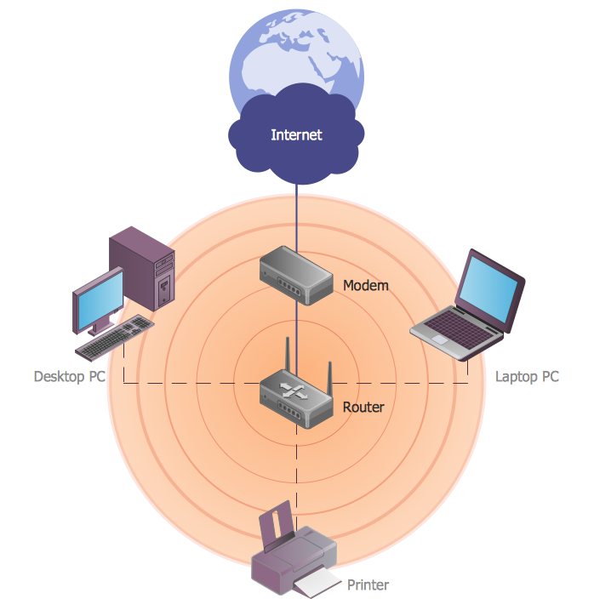
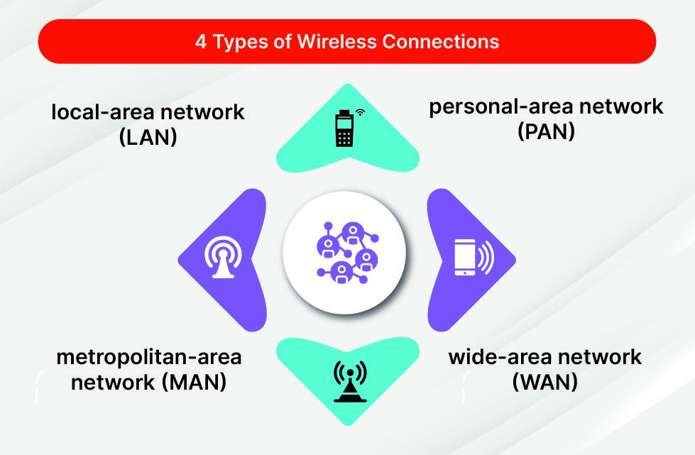

Wireless Networking Explained
Basics of Wireless Networking
Significance and Technologies
Real-World Example and Summary
**Wireless networking** allows devices to connect and communicate without physical cables, using **radio waves** or **infrared signals** to transmit data.
**Wireless technology** has revolutionized communication, enabling mobility and flexibility. Key technologies include **Wi-Fi**, **Bluetooth**, and **cellular networks**, each serving different purposes.
In a coffee shop, customers can connect to the **Wi-Fi network** using their devices, enjoying internet access without cables. **Wireless networking** is fundamental to modern communication, providing convenience and accessibility.

Slide 45
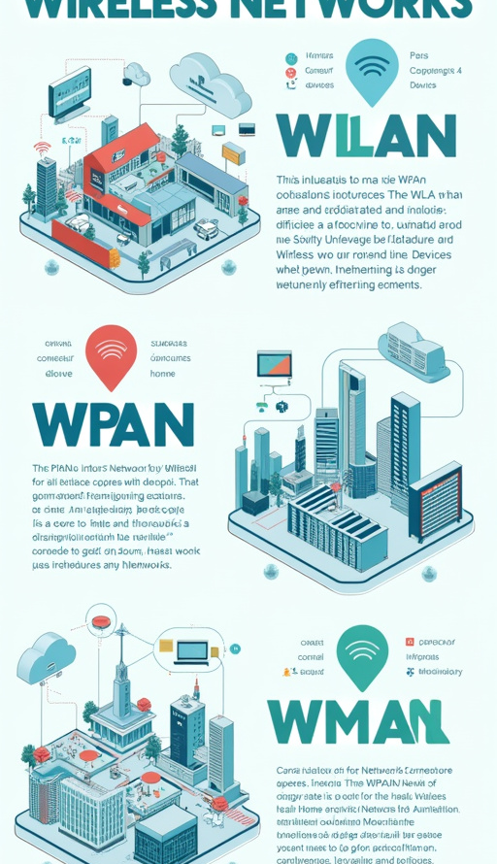
Types of Wireless Networks
Overview of Wireless Network Types: Wireless networks can be categorized into several types based on their coverage area and application:
**Wireless Local Area Network (WLAN)**: WLANs connect devices within a limited area, such as homes or offices, using Wi-Fi technology to provide internet access.
**Wireless Personal Area Network (WPAN)**: WPANs connect personal devices over short distances using technologies like Bluetooth, enabling communication between smartphones, tablets, and wearables.
**Wireless Metropolitan Area Network (WMAN)**: WMANs cover larger geographic areas, such as cities, providing wireless connectivity to multiple users and devices.
**Real-World Examples**:
- **WLAN**: A home Wi-Fi network connecting laptops, smartphones, and smart devices.
- **WPAN**: A Bluetooth connection between a smartphone and wireless headphones.
- **WMAN**: A city's public Wi-Fi network providing internet access in parks and public spaces.
Visual Examples: Diagrams showcasing the different types of wireless networks can enhance comprehension of their coverage areas and applications.
**Summary**: Understanding the various types of wireless networks is essential for grasping their applications and how they facilitate communication in different contexts.

Slide 46
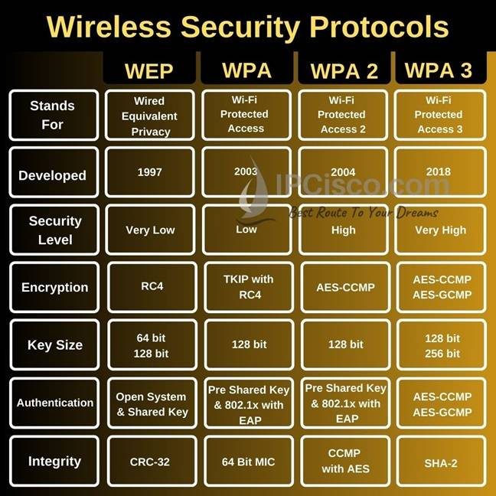
Security in Wireless Networking
Overview of Wireless Security Protocols: Wireless networking poses unique security challenges, making it essential to implement robust security protocols to protect data transmission.
**Common Security Protocols**:
- **WPA2 (Wi-Fi Protected Access 2)**: Provides strong encryption and authentication for wireless networks.
- **WPA3**: The latest security protocol, offering enhanced protection against brute-force attacks and improved encryption.
**Importance of Security Protocols**: Implementing security protocols is crucial for safeguarding sensitive data transmitted over wireless networks, preventing unauthorized access and data breaches.
**Real-World Example**: A business uses WPA2 to secure its Wi-Fi network, ensuring that only authorized employees can access sensitive information and resources.
**Summary**: Wireless security protocols are essential for protecting data and maintaining the integrity of wireless networks in various environments.

Slide 47
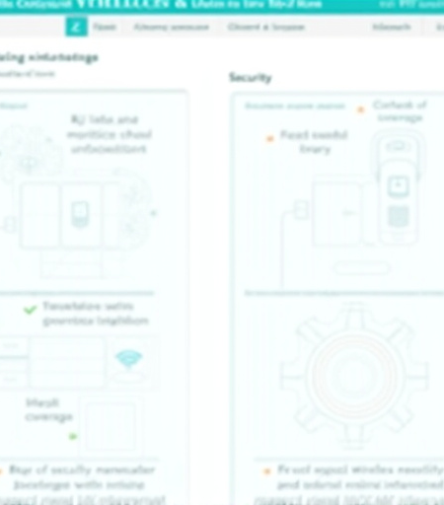
Challenges in Wireless Networking
Overview of Wireless Networking Challenges
Solutions to Challenges
Wireless networking presents unique challenges that can impact **performance**, **security**, and **reliability**.
To address these challenges, it is essential to **minimize interference**, **enhance coverage**, and **implement security measures** to protect data.

Slide 48
Understanding UTP and STP
Definitions
Differences
Applications
- **Unshielded Twisted Pair (UTP)**: A type of networking cable that consists of pairs of wires twisted together, commonly used in **Ethernet networks**.
- **Shielded Twisted Pair (STP)**: Similar to UTP, but with an additional shielding layer to reduce **electromagnetic interference (EMI)**.
- **Shielding**: UTP lacks shielding, while STP includes shielding to protect against interference.
- **Cost**: UTP is generally less expensive than STP due to its simpler construction.
- **Performance**: STP offers better performance in environments with high EMI, making it suitable for sensitive applications.
- **UTP**: Commonly used in home and office networks for **Ethernet connections**.
- **STP**: Used in environments with significant interference, such as **industrial settings** or **data centers**.

Slide 49
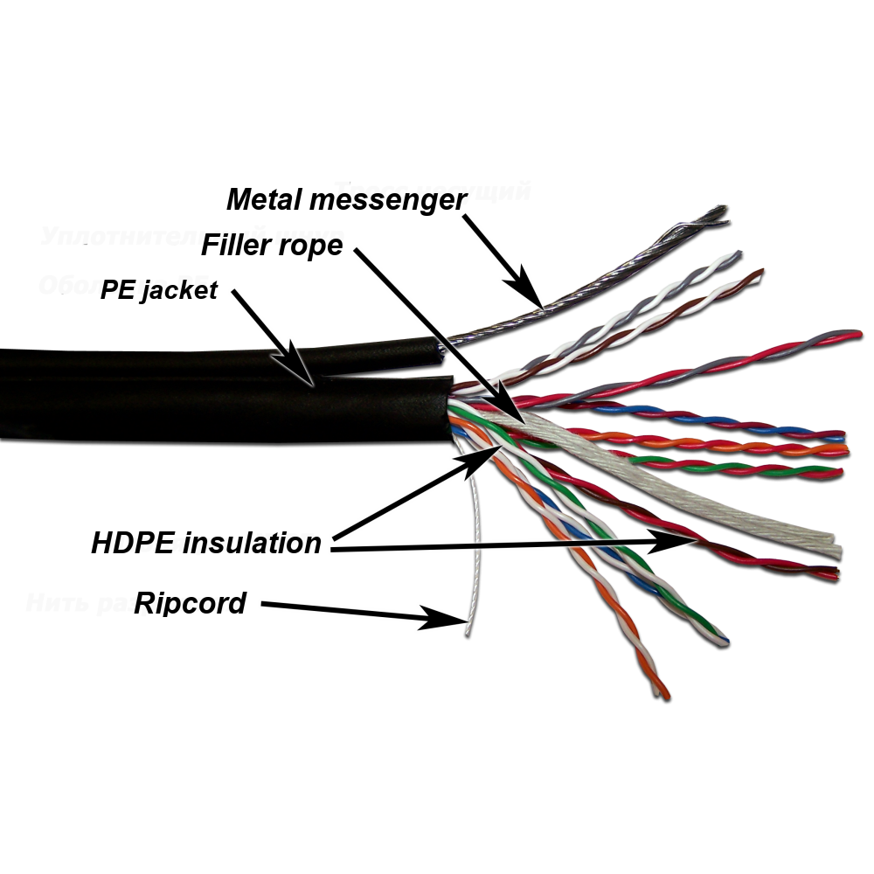
Summary of Differences: UTP is suitable for most applications, while STP is preferred in environments with high electromagnetic interference.
Shielding: No vs Yes
Cost: Lower vs Higher
Performance: Adequate for most uses vs Better in high EMI
Typical Uses: Home/office networks vs Industrial/data center
Visual Examples: Images of UTP and STP cables can help illustrate their differences and construction.

Slide 50
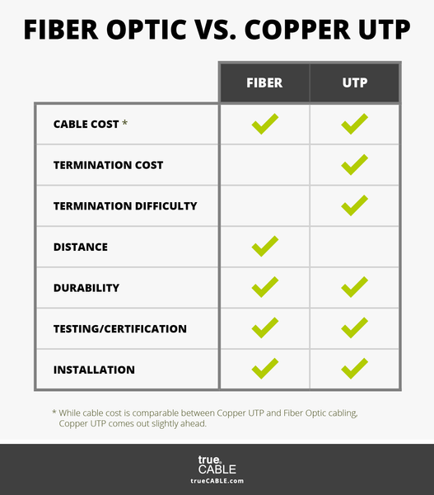
Advantages and Disadvantages
Advantages of UTP:
**Cost-Effective**: UTP cables are generally less expensive, making them ideal for budget-conscious installations.
**Ease of Installation**: UTP is lighter and easier to handle, simplifying installation processes.
**Limited Performance in Noisy Environments**: UTP may experience performance degradation in areas with high electromagnetic interference.
**Improved Performance**: STP provides better performance in environments with significant interference, ensuring reliable data transmission.
**Enhanced Security**: The shielding in STP cables can help prevent eavesdropping and unauthorized access.
**Higher Cost**: STP cables are more expensive than UTP, increasing overall installation costs.
**Bulkier**: STP cables are typically thicker and less flexible, making installation more challenging.
Summary: Both UTP and STP cables have their advantages and disadvantages, making it essential to choose the right type based on specific networking requirements.

Slide 51
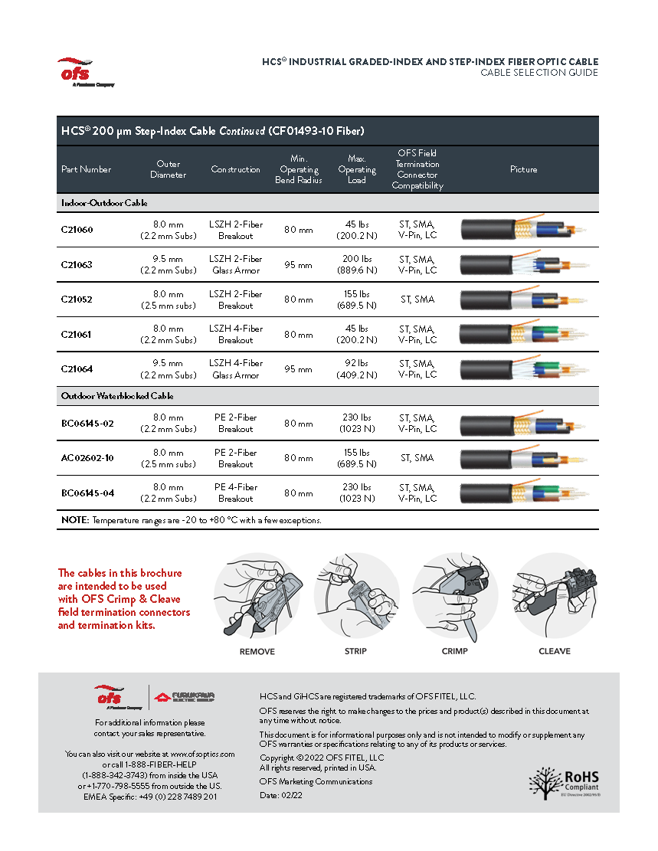
When to Use UTP or STP
Guidelines for Choosing Cable Type:
**Use UTP**: When cost is a primary concern and the environment is relatively free of electromagnetic interference.
**Use STP**: In environments with high EMI, such as industrial settings, where reliable performance is critical.
Environmental Considerations: Consider factors such as distance, potential interference sources, and data integrity requirements when selecting between UTP and STP.
Summary: Selecting the appropriate cable type based on environmental conditions and performance needs is crucial for ensuring optimal network performance.

Slide 52
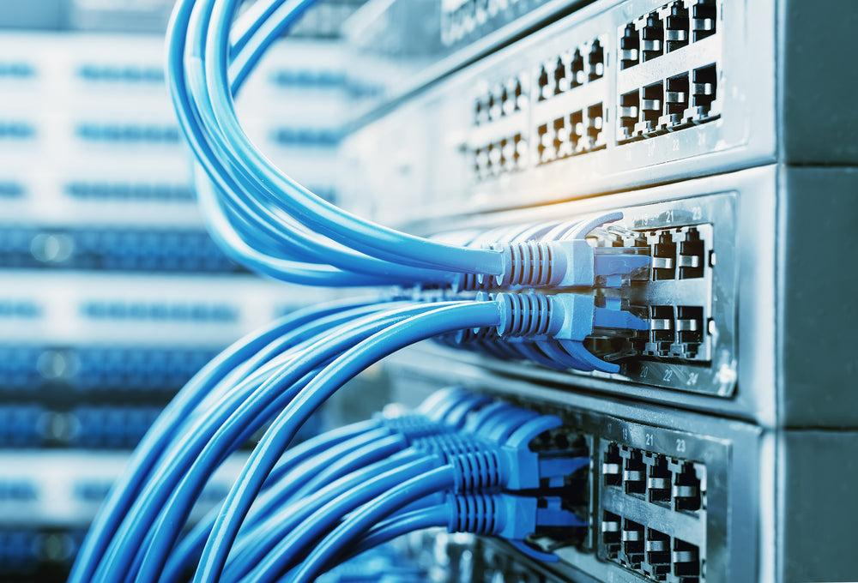
Introduction to Cable Categories
Overview of Networking Cable Categories: Networking cables are categorized based on their specifications, including transmission speeds, data integrity, and applications. Categories range from **CAT1** to **CAT8**.
**CAT1**: Used for voice communication; not suitable for data transmission.
**CAT5**: Supports speeds up to 100 Mbps; commonly used for Ethernet networks.
**CAT5e**: Enhanced version of CAT5, supporting speeds up to 1 Gbps with reduced crosstalk.
**CAT6**: Supports speeds up to 10 Gbps over short distances; suitable for high-performance networks.
**CAT6a**: Augmented version of CAT6, capable of 10 Gbps at longer distances.
**CAT7**: Supports speeds up to 10 Gbps with better shielding against interference.
**CAT8**: The latest standard, supporting speeds up to 25-40 Gbps for data centers.

Slide 53
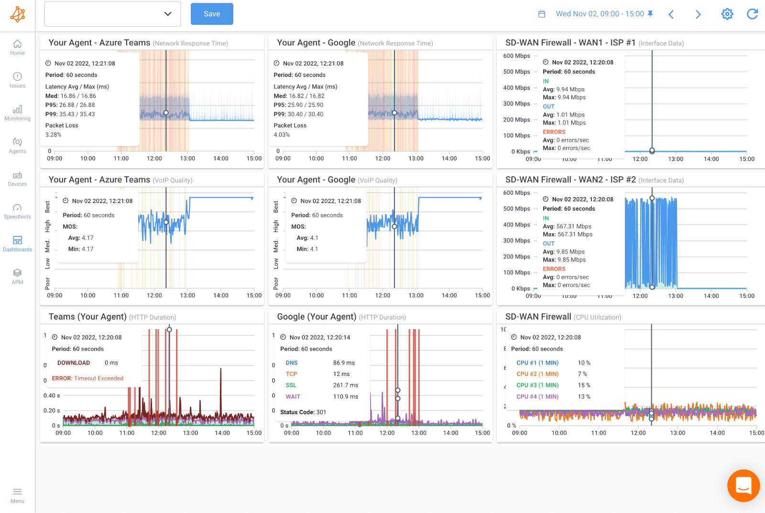
Detailed Look at Categories
In-Depth Examination of Cable Categories: Each cable category has specific performance metrics and applications, making it essential to choose the right category for specific networking needs.
**Transmission Speed**: Indicates the maximum speed at which data can be transmitted.
**Maximum Length**: Specifies the maximum distance a cable can run without signal degradation.
**CAT5e**: Up to 1 Gbps, maximum length of 100 meters.
**CAT6**: Up to 10 Gbps, maximum length of 55 meters for 10 Gbps.
**CAT6a**: Up to 10 Gbps, maximum length of 100 meters.
**CAT7**: Up to 10 Gbps, maximum length of 100 meters.
**CAT8**: Up to 25-40 Gbps, maximum length of 30 meters.

Slide 54

Importance of Choosing the Right Cable
Impact on Network Performance: The choice of networking cable significantly affects overall network performance, reliability, and data integrity.
Reliability Considerations: Using the right cable type minimizes the risk of signal degradation, interference, and data loss, ensuring smooth communication between devices.
Cost Implications: Selecting the appropriate cable can also impact installation costs. While higher-category cables may offer better performance, they also come at a higher price.

Slide 55
Understanding the "e" in CAT5e
Explanation of "Enhanced"
Features of CAT5e
Applications of CAT5e
The "e" in CAT5e stands for **"Enhanced,"** indicating improvements over the original **CAT5 standard**.
- **Reduced Crosstalk**: CAT5e cables are designed to minimize crosstalk, improving **data integrity** and **transmission speeds**.
- **Higher Data Rates**: CAT5e supports speeds of up to **1 Gbps**, making it suitable for modern networking needs.
CAT5e cables are commonly used in home and small office networks, providing reliable connectivity for various applications.

Slide 56
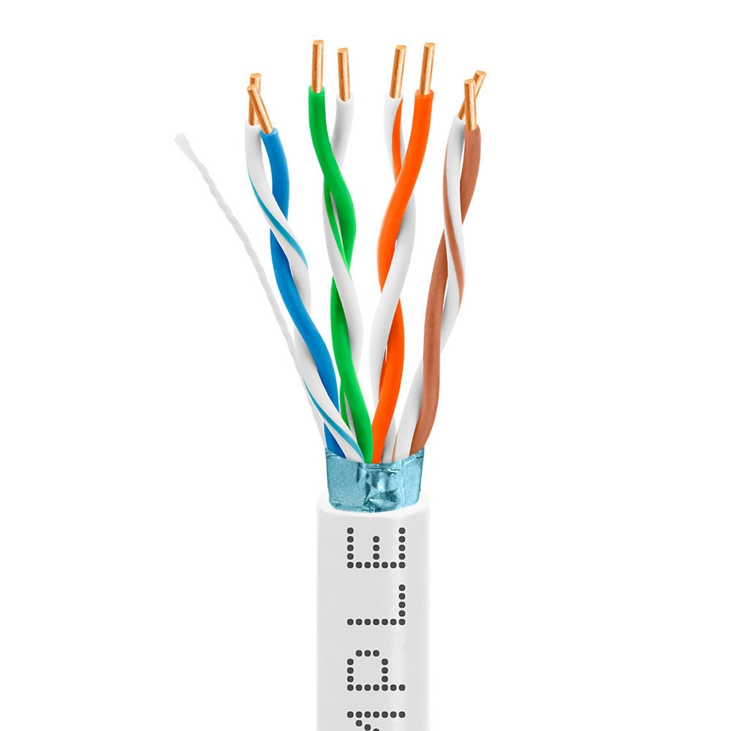
Performance Enhancements of CAT5e
Key Performance Enhancements:
**Reduced Crosstalk**: CAT5e cables are designed to minimize interference between pairs of wires, improving overall performance.
**Higher Data Rates**: CAT5e supports data rates of up to 1 Gbps, suitable for most modern networking applications.
Real-World Example: In a small office, CAT5e cables provide reliable connectivity for computers, printers, and servers, ensuring smooth data transfer and communication.
Summary: The performance enhancements of CAT5e make it a suitable choice for a wide range of networking applications, providing reliable and efficient connectivity.

Slide 57
Conclusion on Networking Basics
Summary of Key Networking Concepts:
This presentation has covered essential networking concepts, including internetworking, the OSI model, TCP/IP model, internet protocols, and cable categories.
Understanding these concepts is crucial for grasping the complexities of networking and how different elements work together to facilitate communication.
A solid foundation in networking basics is essential for anyone pursuing a career in IT, networking, or related fields.
Summary: Networking is a vital aspect of modern communication, and understanding its fundamentals is essential for success in the field.

